Slide 1
DATA MINING FINAL PROJECT
Team: DataQuarry Innovators
Team Members: Gautam Raghu Mithila Reddy Chitukula Srinija Srimamilla

Slide 2



Problem Statement
Develop a predictive model to forecast bankruptcy of firms
Utilize 64 predictors, highlighting profitability and asset management, and 1 target variable
Evaluate various modelling techniques and identify the best predictive model using AUC

Slide 3
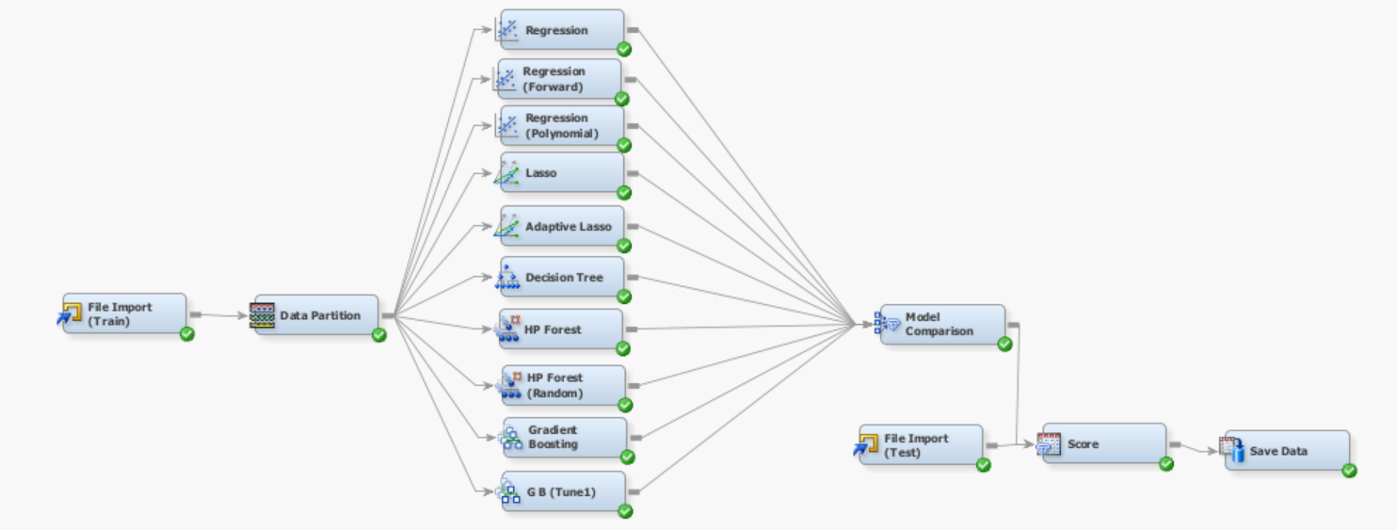
Test-0

Slide 4
Test-0

Slide 5
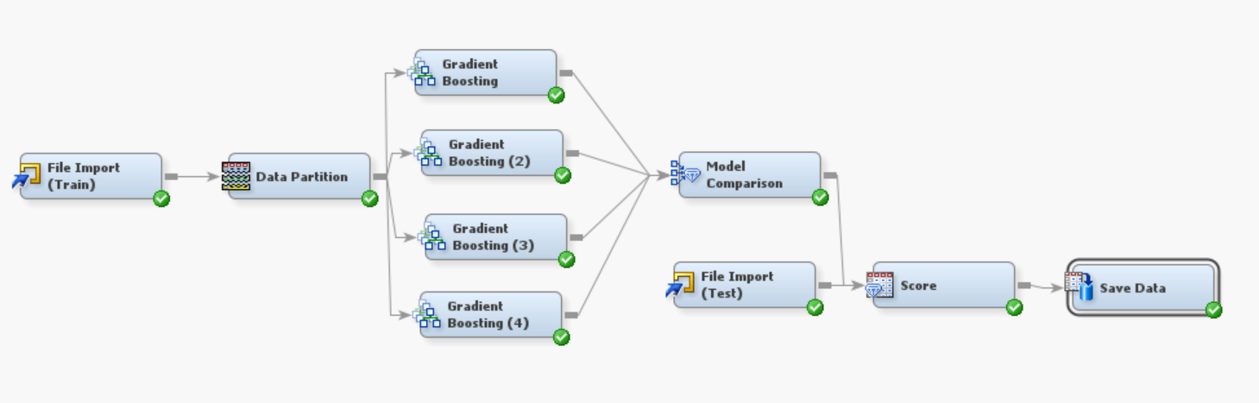
Test-1

Slide 6
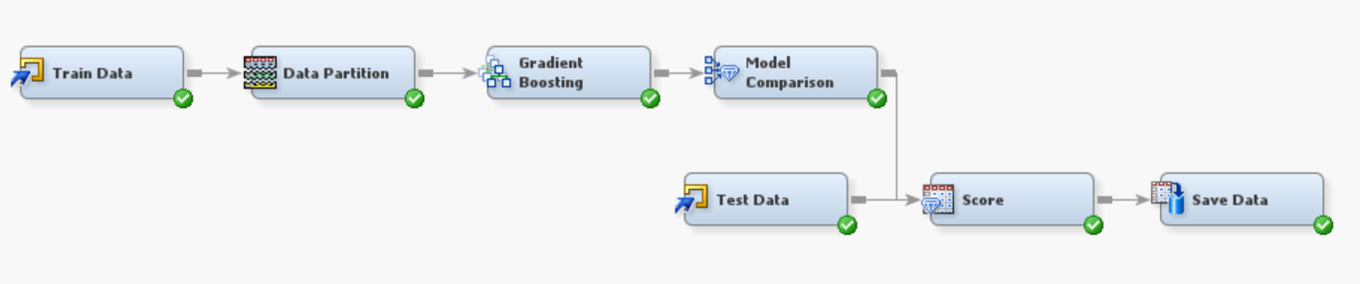
Our Second-Best Model

Slide 7
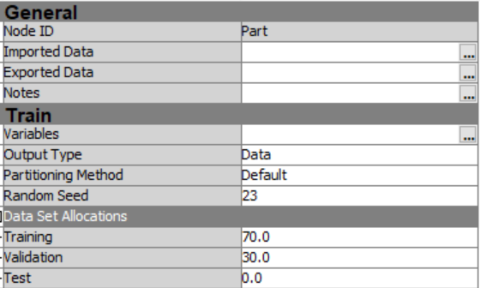
Data Partition Node
-Training Set: 70% -Validation Set: 30%

Slide 8
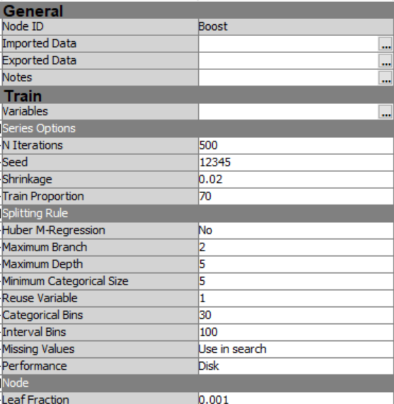
Gradient Boosting Node

Slide 9
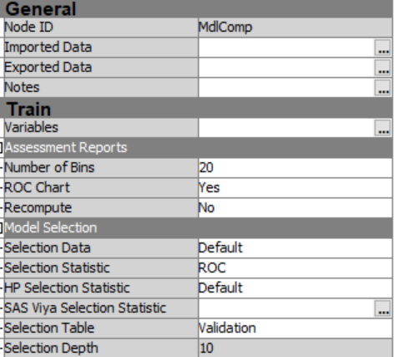
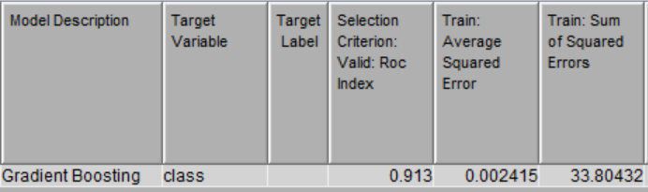
Model Comparison Node
-Selection Stat: ROC

Slide 10
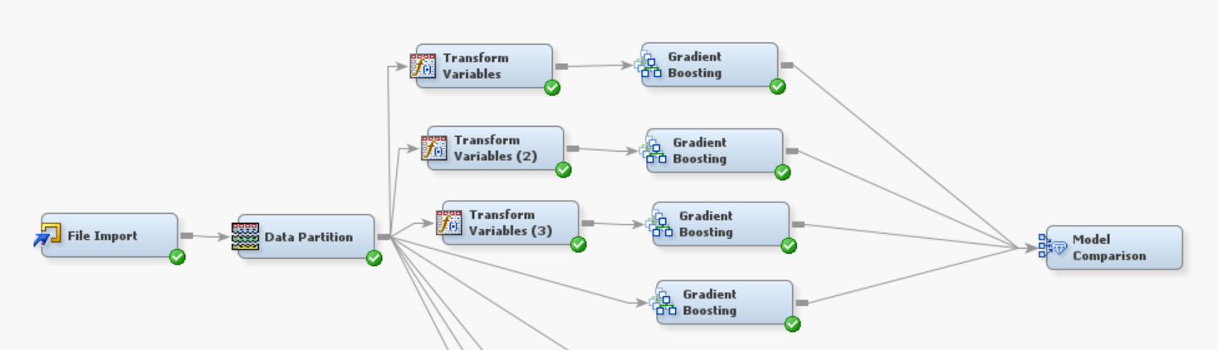
Test-3

Slide 11
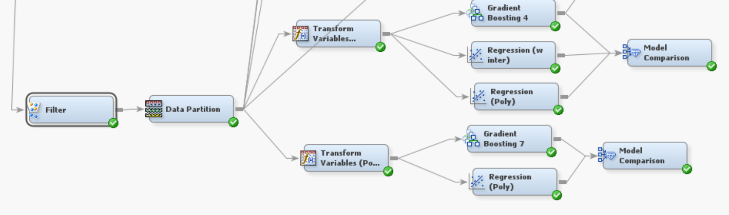
Test-4

Slide 12
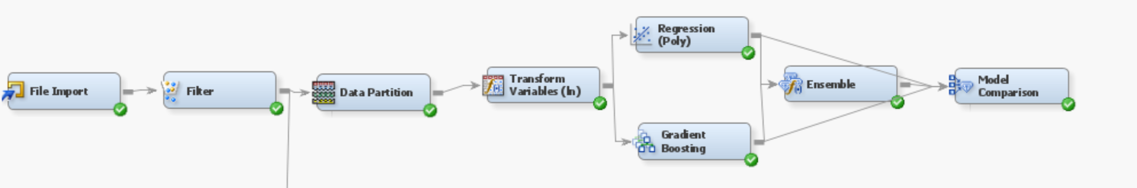
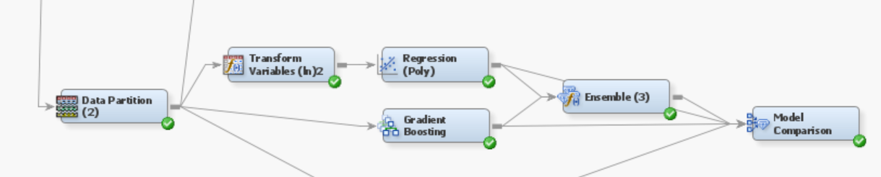
Test-5

Slide 13
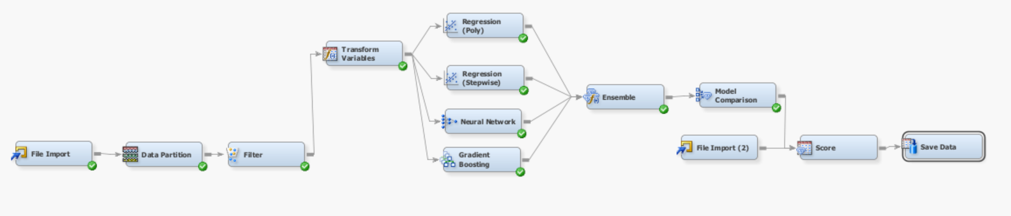
Test-6

Slide 14
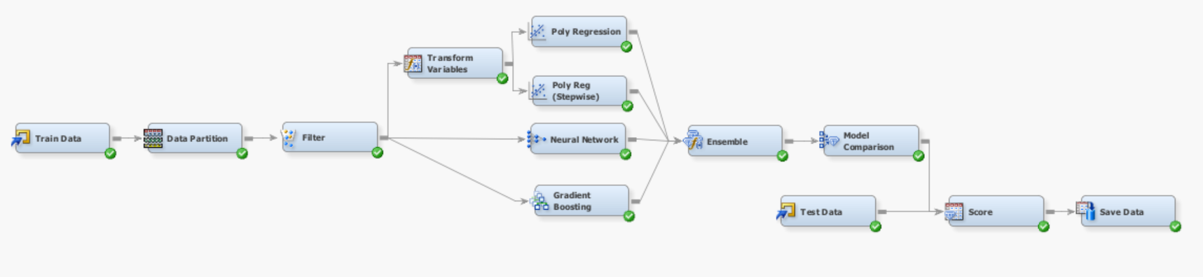
Our Final Model

Slide 15
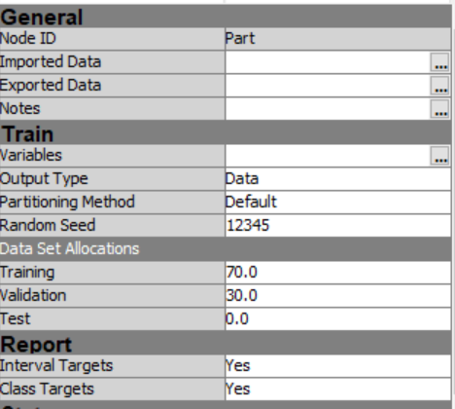
Sample
Data Partition Node -Training Set: 70% -Validation Set: 30%

Slide 16
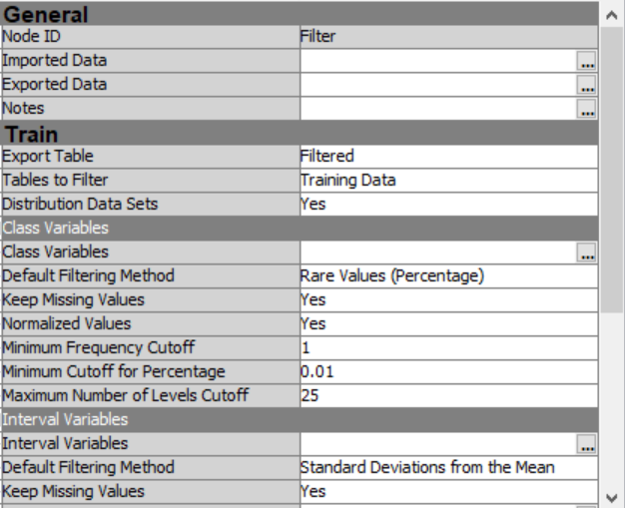
Filter Node
-Default properties

Slide 17
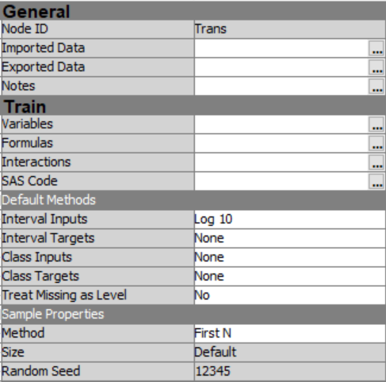
Modify
Transform Variables Node

Slide 18
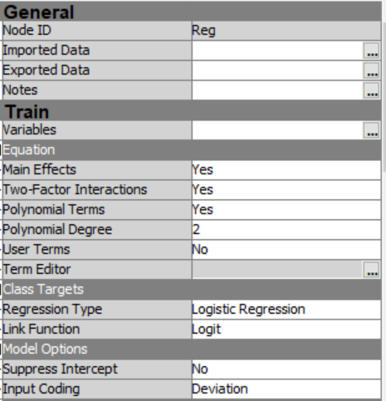
Model
Regression Node (Polynomial)

Slide 19
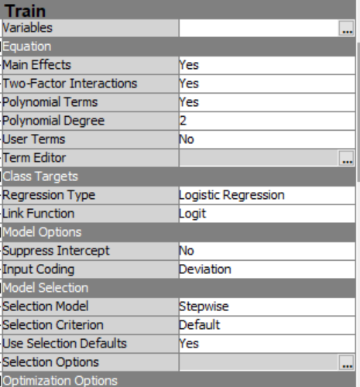
Regression Node (Stepwise)

Slide 20
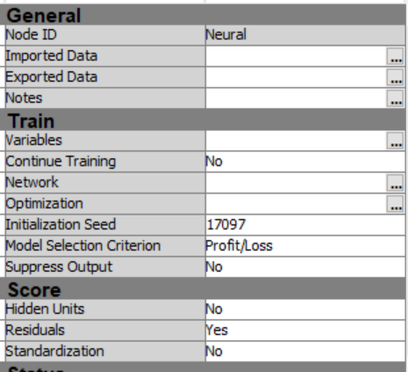
Neural Network Node
-Property Changes in Network and Optimizatrion

Slide 21
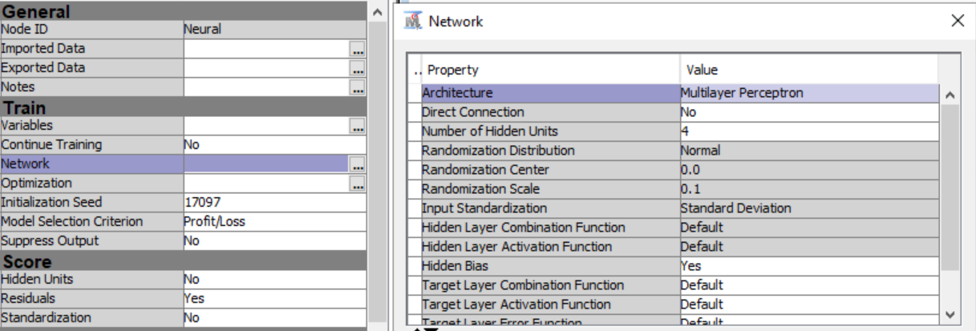
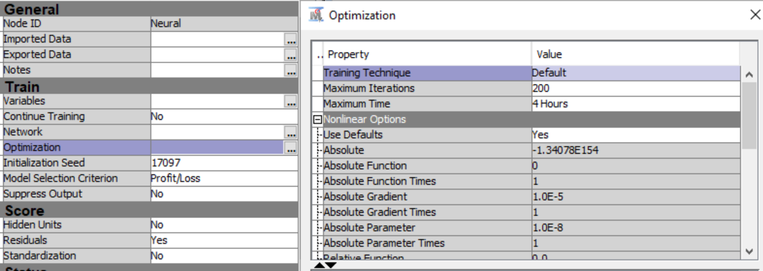
Network Properties
Optimization Properties

Slide 22
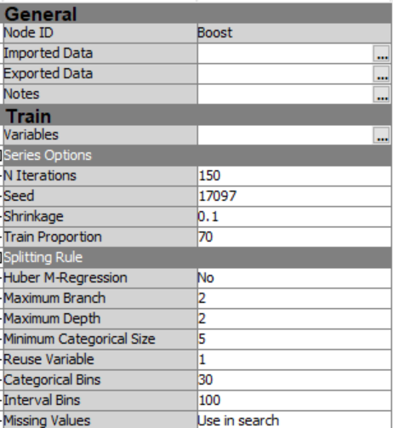
Gradient Boosting Node

Slide 23
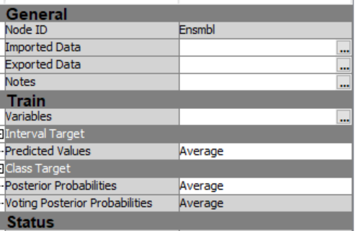
Ensemble Node
-Default Properties

Slide 24
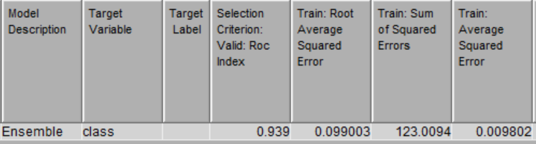
Model Comparison Node
-Selection Stat: ROC

Slide 25
Lessons Learnt
- Different parameter settings worked for different models.
- Data Transformation like applying log and creation of interaction terms worked well with Regression Models.
- An Ensemble of your two best models need not be the best Ensemble model.

Slide 26
Thank You

